Slide 1


Introduction to Git and GitHub
Fondren Library
Digital Scholarship Services

Slide 2
WHAT IS GIT?

Slide 3
WHAT IS GIT NOT?

Slide 4
WHAT IS GITHUB?

Slide 5
WHAT IS GITHUB NOT?

Slide 6
STRUCTURE OF A GIT REPOSITORY
Snapshots, Locality, State Cycle

Slide 7
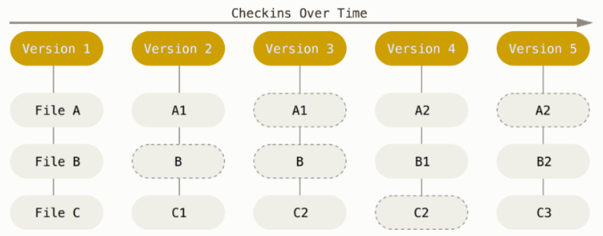
SNAPSHOTS
Stores the entire file structure at each snapshot, not a set of changes!

Slide 8
LOCALITY
Snapshots stored on your computer, not a server!
.git directory
Stores entire history of project

Slide 9
STATES OF FILES IN A REPOSITORY
untracked: git has not been told about this file.
modified: we told git about this file, but we've changed it without telling git to remember our change.
staged: we have told git about this file and told git we will want it to remember our change.
committed: we have made git take a snapshot of our file.

Slide 10
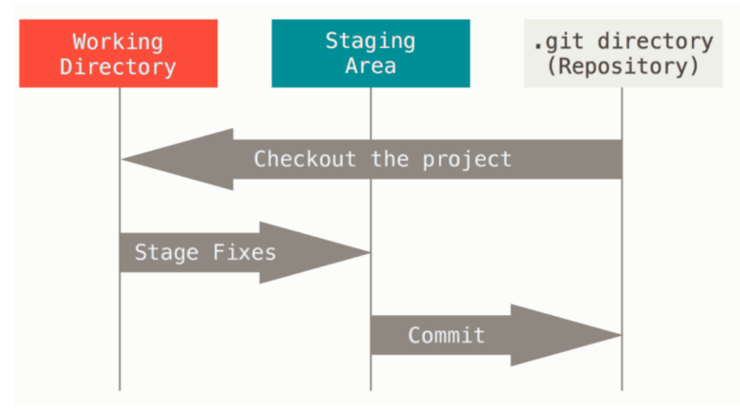
STATES OF FILES IN A REPOSITORY

